Slide 1
CSE / ISYE / MGT 6748 • APPLIED ANALYTICS PRACTICUM
IT Client Engagement & Account Retention Intelligence
Midterm Progress Report: Operational Pipeline, Dynamic Behavioral Features, Baseline Modeling, and Alpha Prototype for Graylogic Technologies
TRACK
INDUSTRY PARTNER
CHECKPOINT
Business Analytics
Graylogic Technologies
Midterm Semester Review

Slide 2
OPERATIONAL CONTEXT
The Cost of Reactive Retention
Late Detection Gap
Silent Spend Decay
Core Practicum Goal
Churn recognized post-cancellation notice.
Billing erodes months prior to departure.
Build 90-day predictive early warning system.

Slide 3
DATA & GOVERNANCE
Data Pipeline & Non-Disclosure Governance
TWO-TIER DATA MODEL
SYLLABUS NDA COMPLIANCE
Clients Tab: Account metadata, verticals, and churn ground truth.
Identity Tokenization: Replaced company names with token hashes.
Monthly Ledger: Monthly invoices, logged hours, and ticket logs.
Financial Rescaling: Applied linear scalar to all dollar revenues.
Data Volume: 150 client accounts across 36 billing months (5,400 transactional rows).
Zero Leakage: Strictly partitioned historical feature windows.

Slide 4
EMPIRICAL OBSERVATIONS
Data Volume & Operational Baselines
150
5,400
22.0%
Tracked enterprise accounts
Monthly transactional logs
Historical baseline churn rate (33 churned / 117 retained)

Slide 5
EXPLORATORY FINDINGS
Leading Signals: Active vs Churned Accounts
Average Payment Lag (Days to Settle Invoice)
Active: 24 Days vs Churned: 68 Days
Trailing 3-Month Spend Velocity (Spend T3M / Spend Prior 3M)
Active: 1.04x vs Churned: 0.58x
Dispute & Escalation Events (Trailing 6 Months)
Active: 0.3 vs Churned: 2.8
Blue: Retained Accounts | Red: Churned Accounts (Sharp behavioural divergence observed 4 months prior)

Slide 6
METHODOLOGY
Engineered Predictive Features
Spend Velocity Ratio
Payment Lag Delta
Escalation Density
Trailing 3M vs prior 12M spend contraction (V_t = S_3M / S_12M).
Widening delay in settling invoices (Delta L_t = L_3M - L_12M).
Concentration of service escalations and disputes over 6 months.

Slide 7
PRELIMINARY MODELING
Midterm Benchmark Model Comparison
Model Architecture | Accuracy | Precision | Recall | AUC-ROC
Logistic Regression (L2 Baseline) | 0.79 | 0.62 | 0.64 | 0.78
Random Forest Classifier | 0.84 | 0.73 | 0.74 | 0.84
XGBoost Classifier (Candidate) | 0.87 | 0.78 | 0.81 | 0.88
XGBoost candidate achieves 88% AUC-ROC and 81% recall under 5-Fold Stratified Cross-Validation, identifying 4 out of 5 at-risk accounts while outperforming the L2 baseline by +10% AUC.

Slide 8
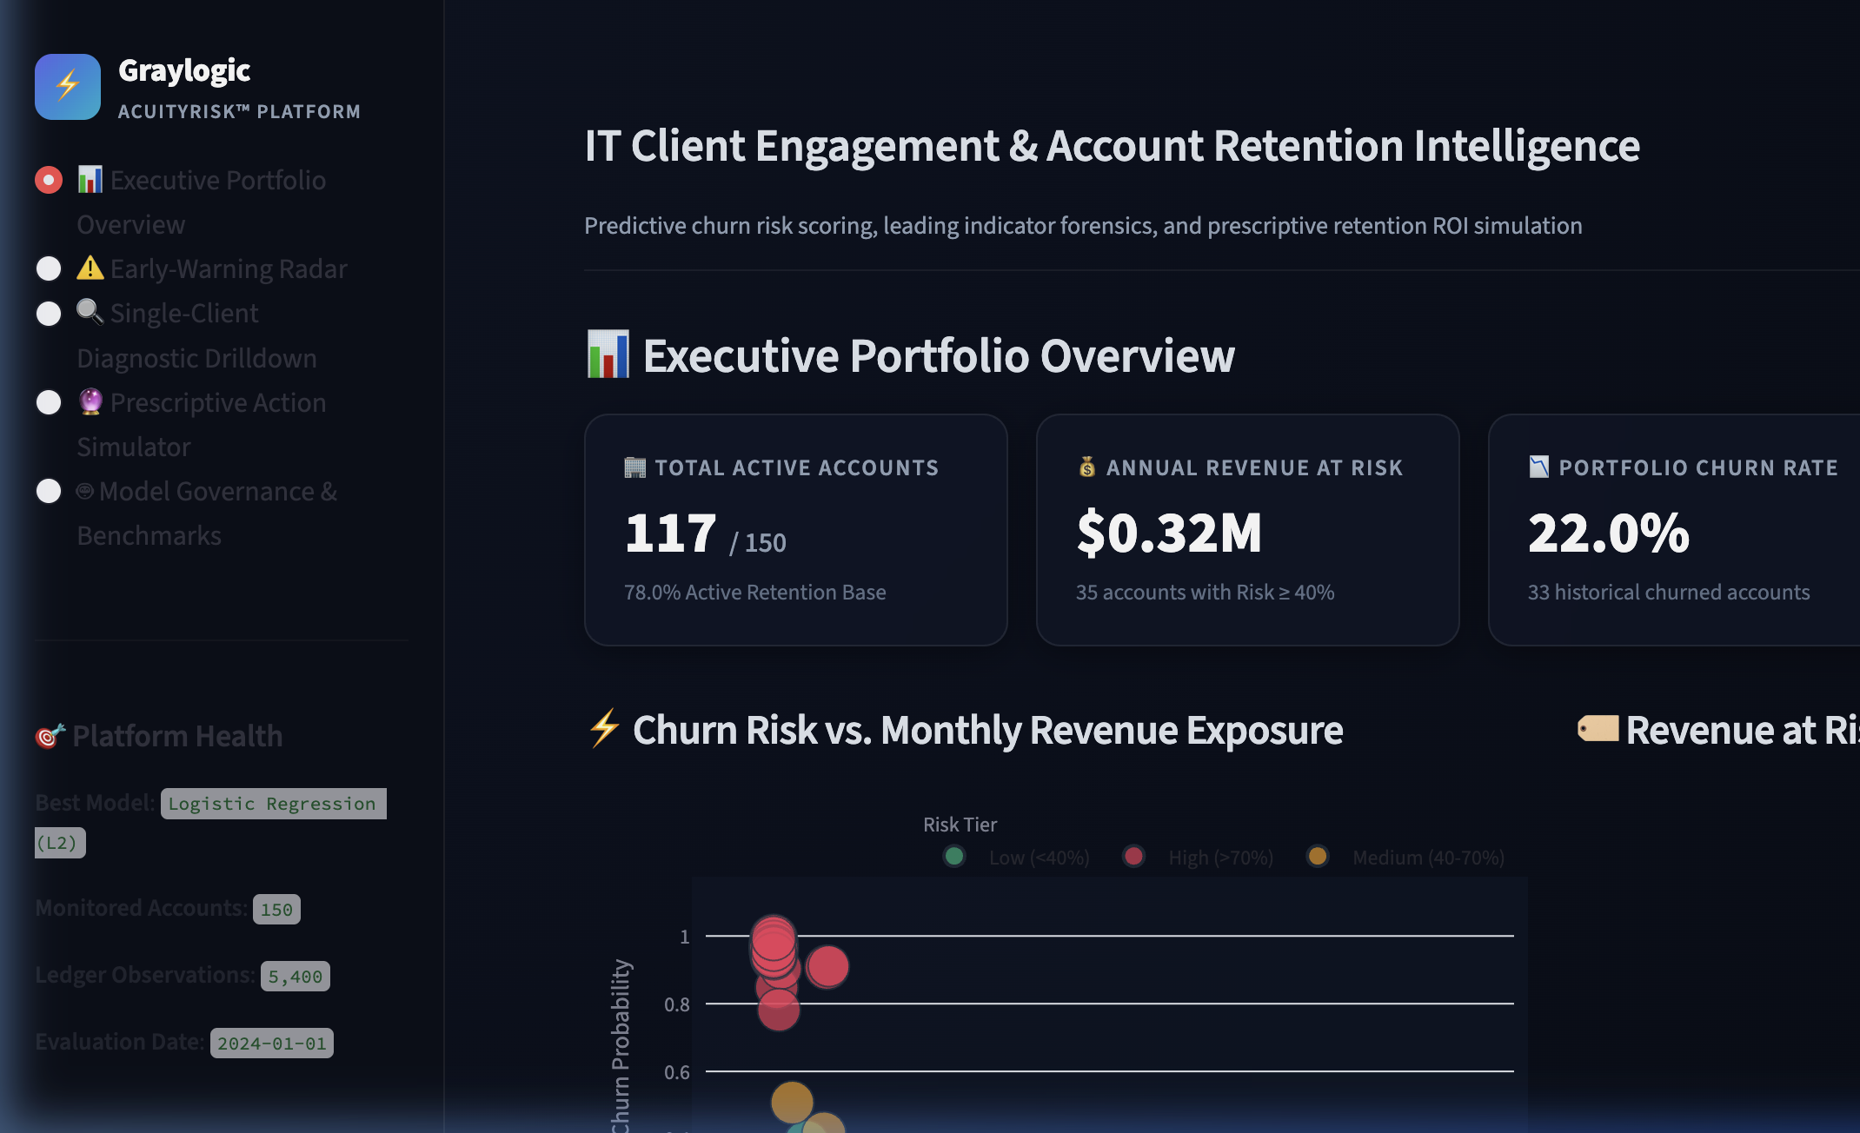
DECISION-SUPPORT SYSTEM
Interactive Decision Workbench (Midterm Alpha Prototype)
Portfolio Risk Radar
Segments and ranks 150 accounts by real-time predicted churn probability.
SHAP Explainability Engine
Decomposes account risk into local SHAP feature attributions.
Prescriptive Action Simulator
Simulates fee concessions and SLA recovery to project retention ROI.

Slide 9
SEMESTER MILESTONES
Roadmap to Final Deliverable
PHASE 1 (COMPLETED • WEEKS 1-4)
PHASE 2 (COMPLETED • WEEKS 5-7)
PHASE 3 (PLANNED • WEEKS 8-10)
PHASE 4 (PLANNED • WEEKS 11-14)
Data & Governance
Features & Alpha Tool
Cost & Survival Tuning
Hardening & Defense
Tokenized 150 accounts, processed 5,400 logs, and enforced NDA compliance.
Engineered 42 behavioral features; ran 5-fold CV; stood up Streamlit Alpha Prototype.
Optimize decision threshold against Graylogic cost matrix; add survival hazard models.
Production hardening, automated reporting, executive defense, and final practicum report.

Slide 10
GEORGIA TECH OMS ANALYTICS PRACTICUM
Questions & Discussion
Thank you for reviewing our midterm progress. We welcome faculty and Graylogic feedback on cross-validation threshold tuning and business intervention cost assumptions.

